Slide 1
Design Document
PowerEnJoy
Peverelli Francesco
Reppucci Federico

Slide 2
EXTERNAL COMPONENTS INTERFACES

Slide 3
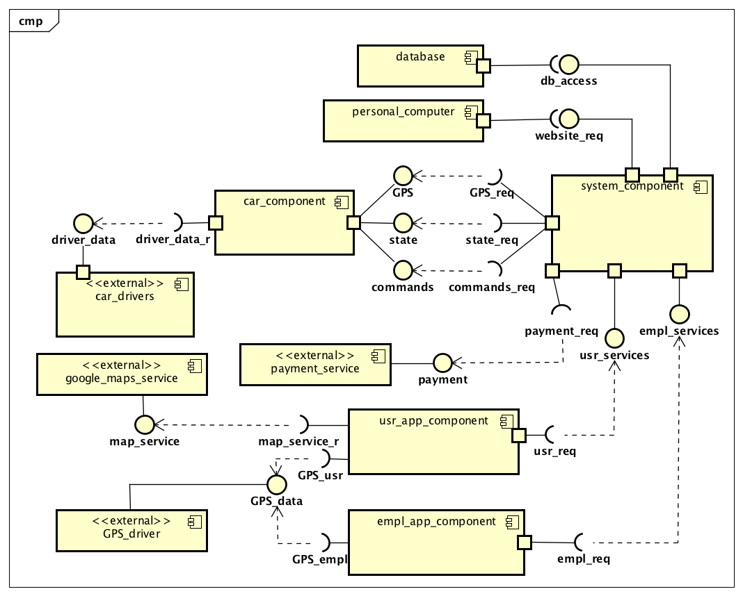
HIGH LEVEL COMPONENTS

Slide 4
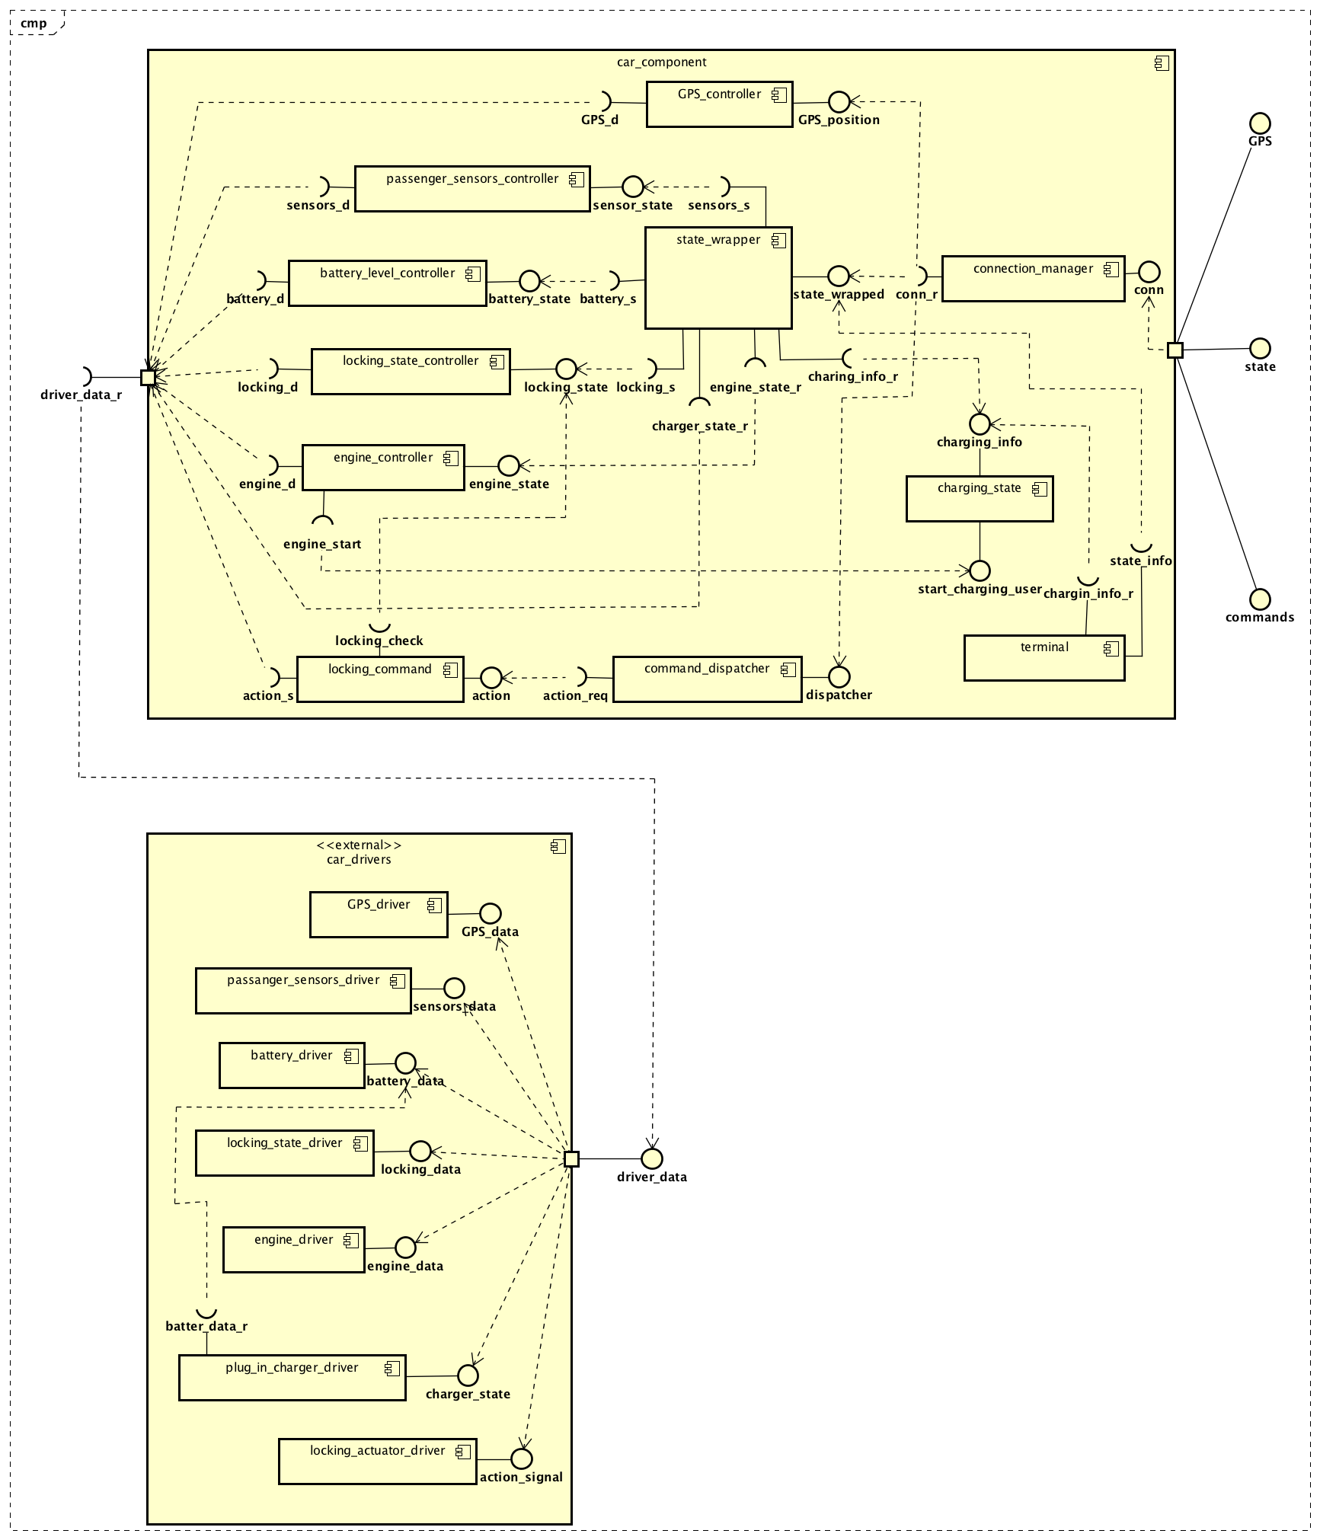
CAR COMPONENT

Slide 5
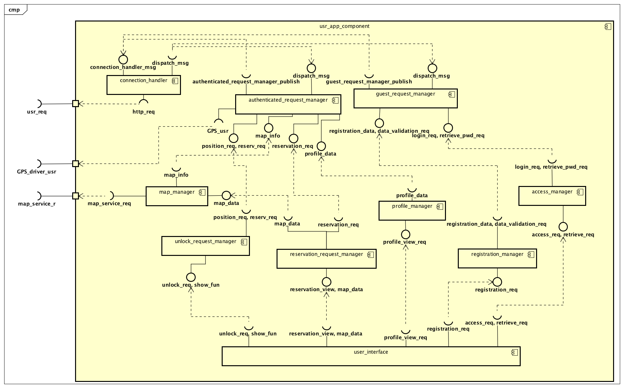
USER APPLICATION COMPONENT

Slide 6
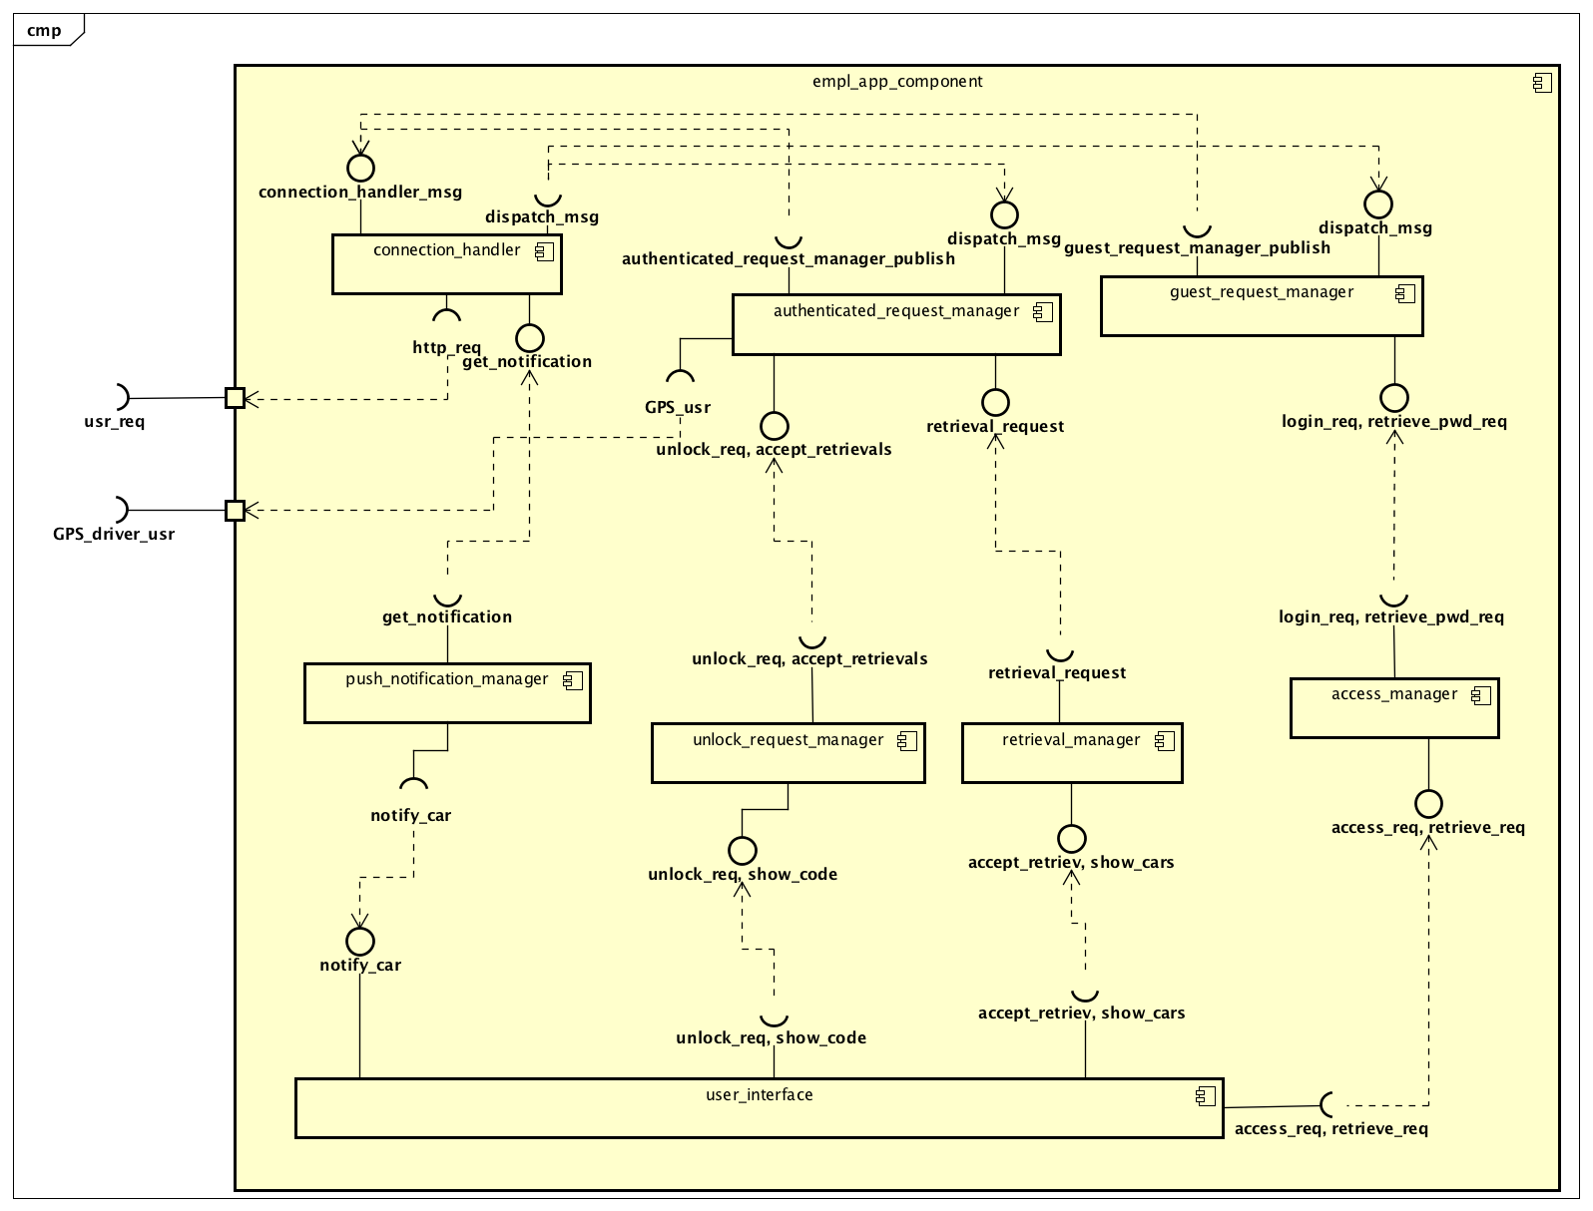
EMPLOYEE APPLICATION COMPONENT

Slide 7
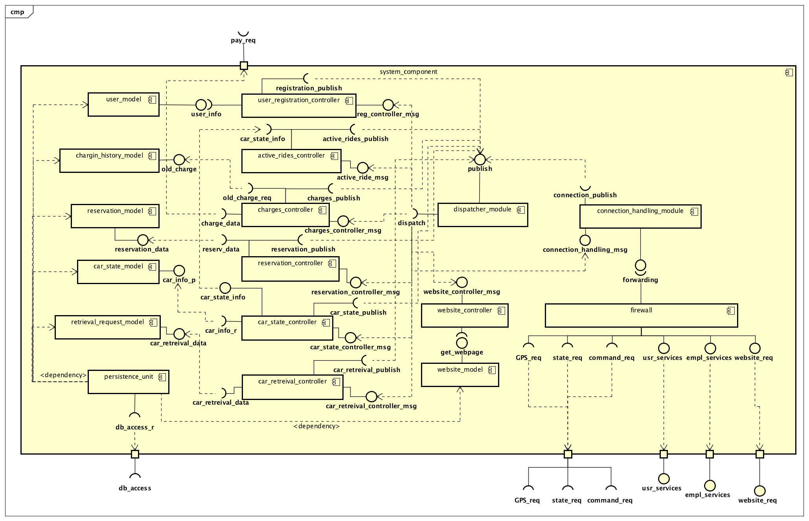
SYSTEM COMPONENT

Slide 8
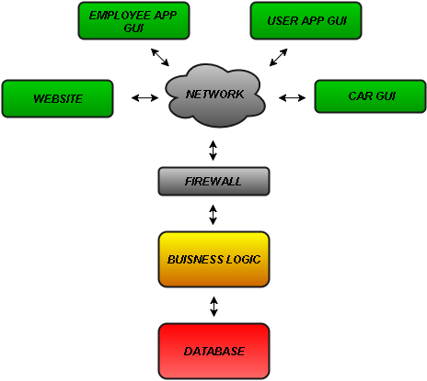
SOFTWARE ARCHITECTURE
The result is a three-tier architecture, where the presentation layer is located on the mobile applications and the car, the business logic is almost entirely on the server's side (although both the mobile apps and the software systems on the car contain some control logic, it is mostly used to formulate requests for the server to evaluate, or to pass on messages to act upon), and the persistency layer comes in the form of a database component.

Slide 9
INTERFACES

Slide 10
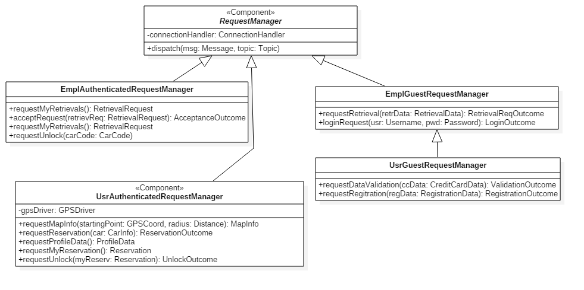
REQUEST MANAGER INTERFACE

Slide 11
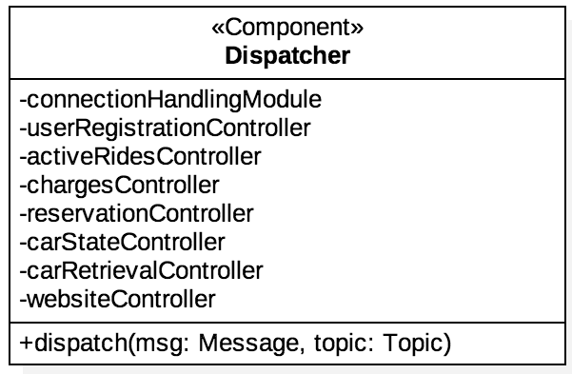
DISPATCHER INTERFACE

Slide 12
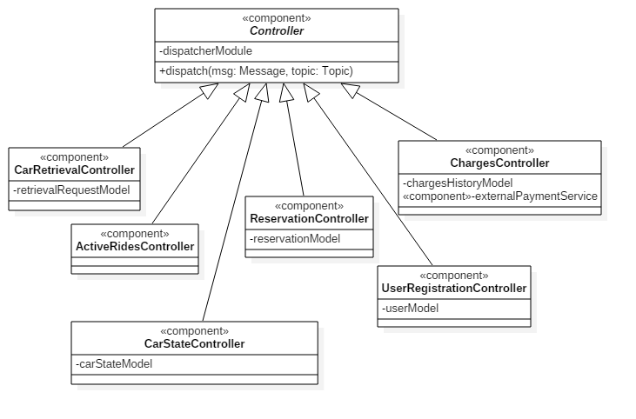
CONTROLLER INTERFACE

Slide 13
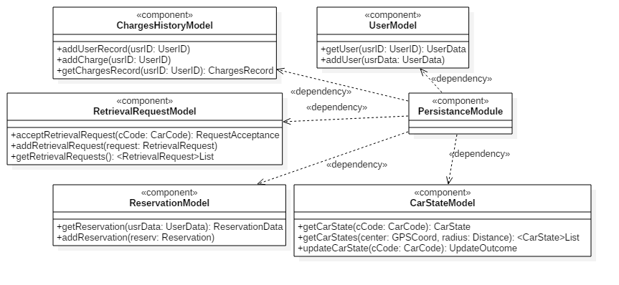
DATA MODEL INTERFACE

Slide 14
RUNTIME SEQUENCE DIAGRAM

Slide 15
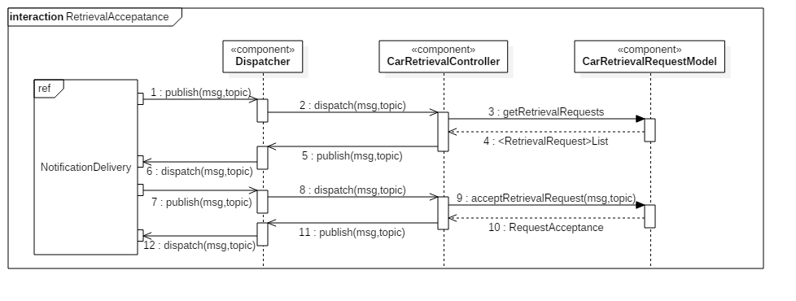
RETRIEVAL ACCEPTANCE PROCEDURE

Slide 16
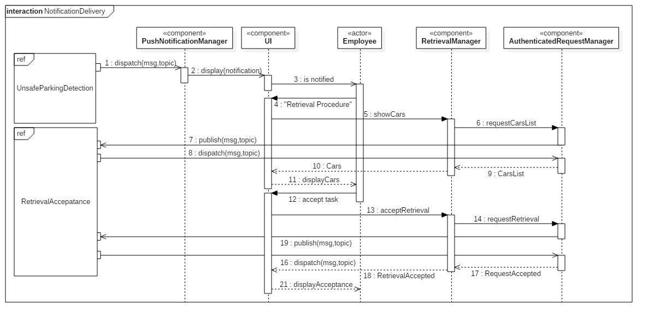
NOTIFICATION DELIVERY PROCEDURE

Slide 17
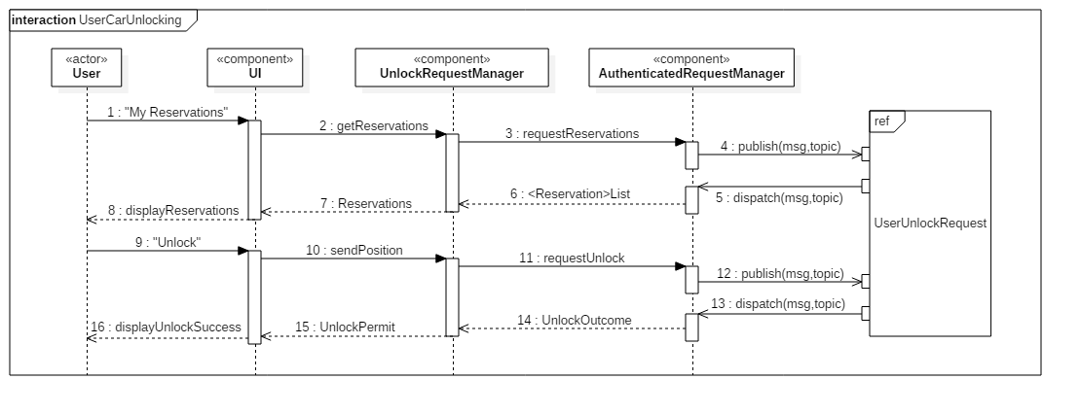
UNLOCKING USER PROCEDURE

Slide 18
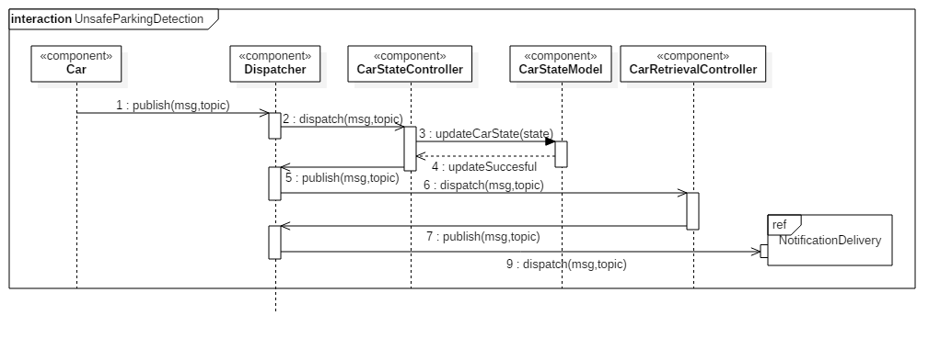
UNSAFE PARKING DETECTION PROCEDURE

Slide 19
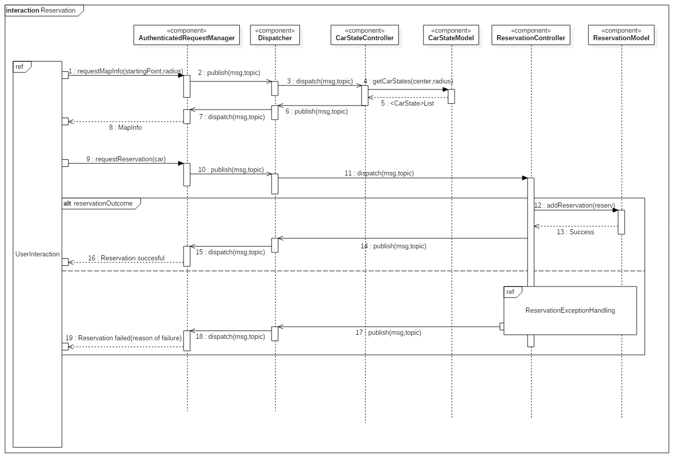
RESERVATION PROCEDURE

Slide 20
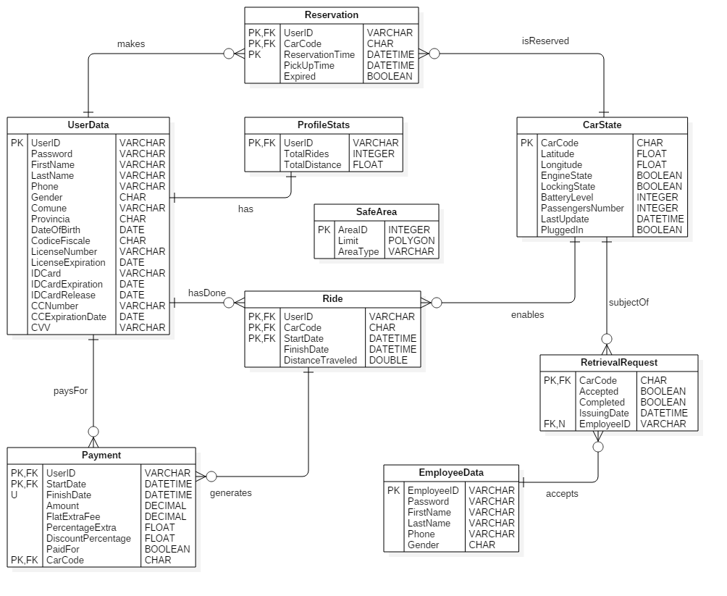
DATA MODEL

Slide 21
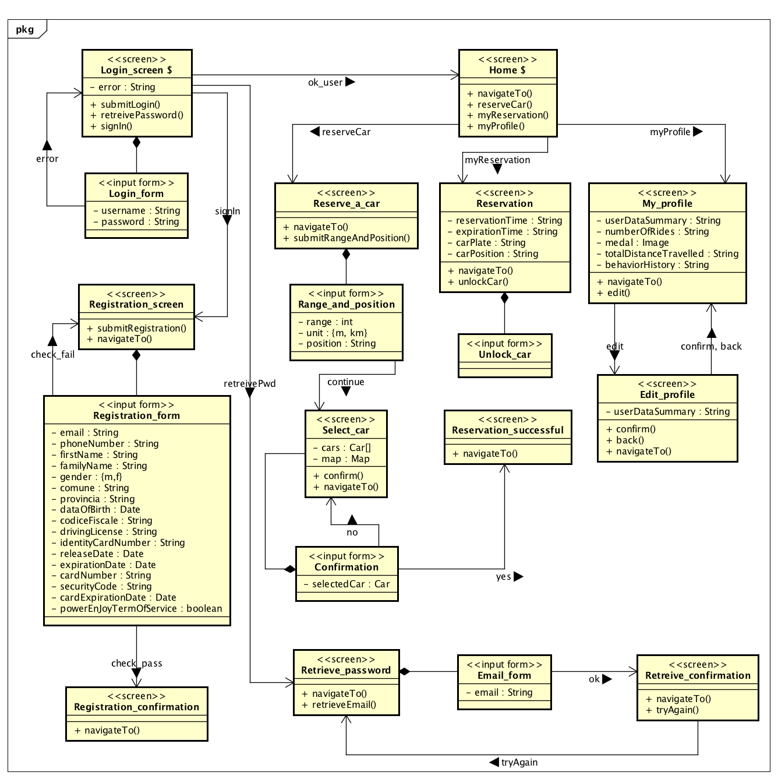
USER INTERFACE DESIGN

Slide 22
SELECTED TOOLS

Slide 23
Operating systems
SUSE Linux Enterprise 10: is the operating system running on the server machines
Microsoft Windows Embedded Automotive: is the operating system that the provided cars come with.
Windows, iOS and Android are identified as the operating systems for which the mobile application will be developed.
Application server
Payara: is an open-source application server derived from Glassfish, and although it's not Java EE certified it is effectively Java EE 7 compliant and offers far more stable patch releases, security fixes, production support and developer support. It also has a very responsive community.
Database
MySQL: among all the available DBMSs, MySQL stands out for its scalability and flexibility, which also comes along with good performances and availability. In addition, it is open source, just like Payara, and can run on multiple platforms. All these reasons contribute to make MySQL our DBMS of choice.

Slide 24
Frameworks
J2EE: is a solid framework which will be used to ease the development of the application logic and the presentation layer for both the website and the apps on the server side.
Windows Automotive Application Framework: is chosen as a native framework that our windows developers are familiar with.
Communication
On the server side JMS is used as the messaging API, and the messages are exchanged in a text-based XML format via SOAP Transport Protocol.
On the client side Kaazing WebSocket Gateway APIs are used to support JMS messaging.
Ides
The selected IDEs are NetBeans for the development of the server-side application, VisualStudio for the development of the software running on the cars, and AndroidStudio, XCode and VisualStudio are the integrated environments selected to develop for Android, iOS and Windows respectively.

Slide 25
DEPLOYMENT

Slide 26
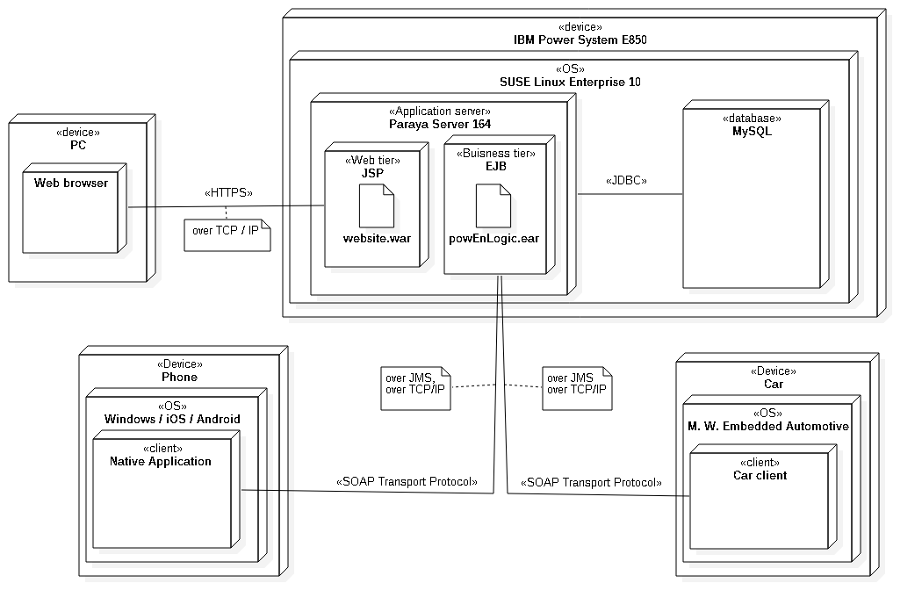
USER INTERFACE DESIGN

Slide 27
ALGORITHM DESIGN

Slide 28
/**
* This class controls whether the reservation is well-formed.
* A reservation is well-formed if:
* 1) the user hasn't already an active reservation, and
* 2) the user hasn't some pending payment, and
* 3) the user's credit card and identity card aren't expired,
* 4) the selected car is actually available
*/
class ReservationController implements Publish, Subscriber{
attribute ReservationModel reservationModel
method void checkAndAddReservation(Reservation reservation) {
try{
doubleReservationCheck(reservation);
lastPaymentCheck(reservation);
validityUserDataCheck(reservation);
carAvailabilityCheck(reservation);
reservationModel.addReservation(reservation);
} catch(DoubleCheckReservation or
PendingPaymentException or
InvalidUserDataException or
NotAvailableCarException){
throw ReservationException
}
}
. . .

Slide 29
. . .
method void doubleReservationCheck(Reservation reservation) {
user = reservation.getUser();
reservationToCheck =
reservationModel.getNotExpiredReservation(user);
if (reservationToCheck != null)
throw DoubleCheckReservation
}
method void doubleReservationCheck(Reservation reservation) {
user = reservation.getUser();
reservationToCheck =
reservationModel.getNotExpiredReservation(user);
if (reservationToCheck != null)
throw DoubleCheckReservation
}
. . .

Slide 30
. . .
method void validityUserDataCheck(Reservation reservation){
userData = reservation.getUser().getUserData();
if (not userData.areValid())
throw InvalidUserDataException
}
method void carAvailabilityCheck(Reservation reservation){
carState = reservation.getCar().getCarState();
if (not carState.isAvailable())
throw NotAvailableCarException
}
}

Slide 31
REQUIREMENTS TRACEABILITY

Slide 32
[R1.1]: The app is available for any person to download and run on his/her phone
This requirement will be achieved at a later stage.
[R1.2]: From the home page of the app any person can carry out the registration procedure
[R1.3]: The registration procedure requires a person's credentials and payment info to be carried out
[R1.4]: The registration procedure uses the external payment service to verify the validity of the provided payment info
[R1.5]: At the end of the registration procedure the person whose credentials were used is registered in the system
[R1.6]: At the end of the registration procedure the person receives an e-mail containing a password which he/she can use to access the system
[R1.7]: At the end of the registration procedure the person can ask the system to send another mail
COMPONENTS: UserInterface, RegistrationManager, GuestRequestManager, UserRegistrationController, UserModel

Slide 33
[RA1.1]: The app allows any person to log in by providing a valid e-mail and password
[RA1.2]: The app does not allow any person who does not provide a valid e-mail and password to log in
[RA2.1]: From the home page of the app the password retrieval procedure can be initiated by any person
[RA2.2]: If a person provides a valid e-mail address during the password retrieval procedure the system sends an e-mail to that address containing the associated password
COMPONENTS: UserInterface, AccessManager, GuestRequestManager, UserRegistrationController, UserModel
[RA3]: Access to the PowerEnJoy's website (a static page) is granted upon request by the system (no login required)
COMPONENTS: WebsiteController, WebsiteModel

Slide 34
[R2.1]: The "Reserve a car" function can be accessed by the user from the home page of
the app [R2.2]: The "Reserve a car" function allows the user to select a range (distance)
[R2.3]: The system acquires the user's current position through the GPS coordinates of the user's phone
[R2.4]: The system tracks all available cars' current position through their GPS coordinates [R2.4.1]: The cars must possess a device which can be tracked via GPS
[R2.5]: The "Reserve a car" function allows the user to select a starting position for the search, which can be either their current location or a given address
[R2.6]: When the user confirms the inserted parameters the search is carried out and the "Reserve a car" function displays to the user the data of the search acquired from the system in a Google provided map

Slide 35
[R3.1]: The app allows the user to tap on any available car on the map displayed as the result of a search conducted through the "Reserve a car" function.
[R3.2]: When a user taps on a car the app generates a pop-up asking the user if he/she wants to confirm the reservation.
[R3.3]: As long as the car was not reserved by another user in the meantime, when the user confirms the car is marked as reserved by the system and the user can see the "Reservation successful!" message on the app.
[R3.4]: When the system marks a car as reserved any reservation request from any user is rejected by the system while the car is in the reserved state.
[R3.5]: A car is in reserved state for one hour from the moment it was marked as reserved.
[R3.6]: A car in reserved state is not signaled by the system during the "Reserve a car" procedure.
[R3.7]: After one hour from its reservation a car is no longer in reserved state.
[R3.8]: A car not in reserved state is considered available by the system only if it is parked in a safe area less than 3 km away from a power grid station and has more than 20% of its battery.
COMPONENTS: UserInterface, ReservationRequestManager, MapManager, AuthenticatedRequestManager, ReservationController, ReservationModel, CarStateController, CarStateModel, + StateWrapper and the controllers on the car providing status updates.

Slide 36
[R4.1]: One hour after a car has been reserved if it was never ignited the system charges for 1 EUR the user who reserved it
COMPONENTS: ReservationModel, ReservationController, ChargesController
[R5.1]: From the home page of the app the user can access the "My reservations" section
[R5.2]: In the "My reservations" section if the user has reserved a car less than an hour ago an active reservation is displayed with an "Unlock" button
[R5.3]: If the user is less than 10 meters away from the car and presses the unlock button the car unlocks
COMPONENTS: UserInterface, UnlockRequestManager, AuthenticatedRequestManager, ReservationController, ReservationManager, CarStateController, CarStateModel, CommandDispatcher, LockingCommand

Slide 37
[R6.1]: When a car is ignited the system starts charging the last user who reserved the car
[R6.2]: When the charging starts, the display on the car shows a "Current charge" field with a number representing the current total charge, which starts from 0
[R6.3]: Once a minute the "Current charge" value is incremented by a set amount
COMPONENTS: EngineController, Terminal, StateWrapper, ChargesController, ChargesHistoryModel, ChargingState

Slide 38
[R7.1]: When a car is stopped and the sensors in the car detect no one inside, if a user was being charged for the car the system stops charging him/her.
[R7.2]: One minute after a car has been stopped and the sensors in the car detect no one inside, the system locks the car.
COMPONENTS: PassengerSensorsController, LockingStateController, StateWrapper, ChargesController, ChargesHistoryModel

Slide 39
[R8]: The moment the car is stopped, if the sensor in the car detected two passengers the system records it as a possible discount of 10%
[R9]: The moment the car is stopped and the sensors in the car detect no one inside, if the car has more than 50% of its maximum battery the system records it as a possible discount of 20%.
[R10]: If before 2 minutes since the moment the car has been stopped and its sensors detected no one was inside the car is plugged in a power grid and its position is within a special parking
[R11.0]: The moment the car is stopped and the sensors in the car detect no one inside, if the safe area nearest to the car is more than 3km away from it, the system records an extra fee of 30%
[R11.1]: The moment the car is stopped and the sensors in the car detect no one inside, if the car has less than 20% of its maximum battery, the system records an extra fee of 30%.
[R12]: After two minutes since the car has been stopped and its sensors detected no one was inside, the system applies all the extra fees and if there are none it applies the highest discount among the possible ones to the cost of the ride.
COMPONENTS: GPS_Controller, PassengerSensorsController, BatteryLevelController, EngineController, StateWrapper, ChargesController, ChargingHistoryModel

Slide 40
[RA4]: If a user with a pending payment procedure tries to reserve a car, a pop-up lets the user know that he/she needs to pay for his/her last ride to be able to reserve a car and the app does not allow the user complete the reservation procedure.
COMPONENTS: ChargesController, ChargesHistoryModel + components for a reservation
[RA5]: If in the user's profile either the credit card or identity card expiration date has already passed, when the user tries to reserve a car a pop-up lets him/her know that the data in the user's profile need to be updated and the app prevents the reservation procedure from being completed
COMPONENTS: UserRegistrationController, UserModel + components for a reservation

Slide 41
[RA6.1]: From the home page of the app the user can access the "My profile" section
[RA6.2]: From the "My profile" section the user can use the "Edit profile" button to modify his/her credential and payment info
[RA6.3]: The system can check via the external payment service whether the payment info inserted are valid
[RA6.4]: If the inserted payment info is valid the user can save the changes by tapping the "Confirm" button.
COMPONENTS: UserInterface, ProfileManager, AuthenticatedRequestManager, UserRegistrationController, UserModel
[RA7]: If the user has already a reservation which is not expired yet when he/she tries to reserve a car, a pop-up lets the user know that he/she cannot reserve a car and the app does not allow the user complete the reservation procedure
COMPONENTS: ReservationController, ReservationModel + other components for a reservation
[RA8]: When a car is locked the system checks its GPS coordinates, and if they correspond to those of a non-safe area the last user who reserved the car is charged for a set extra fee.
COMPONENTS: GPSController, CarStateController, CarStateModel

Slide 42
[R13.1]: Each employee has access to an application, AdminPowerEnJoy, on their phone
[R13.2]: When a car is locked the system checks its GPS coordinates, and if they correspond to those of a non-safe area all employees are notified through AdminPowerEnJoy that the car needs to be retrieved
[R13.3]: AdminPowerEnJoy allows an employee to accept a retrieval request through the "Retrieval procedure" function
[R13.4]: If an employee has already accepted a retrieval request, the retrieval request can no longer be accepted
[R13.5]: After 12 hours, if an employee has accepted a retrieval request but has not retrieved the car, the request is issued again by the system and another employee can accept it
[R13.6]: When an employee is notified of a car to retrieve, the notification contains the information necessary to set up the navigator of the company's cars to find the position of the car to retrieve
[R13.7]: AdminPowerEnJoy allows an employee to unlock any car for which he/she has accepted a retrieval request
COMPONENTS: UserInterface, RetrievalManager, PushMotificationManager, UnlockrequestManager, AuthenticatedRequestManager, CarStateController, CarStateModel, CarRetrievalController, RetrievalRequestModel

Slide 43
[R14]: When the employee ignites a car which was opened through AdminPowerEnJoy the system does not initiate any charging procedure
COMPONENTS: UnlockRequestManager, AuthenticatedRequestManager, CarStateController, CarStateModel, CommandDispatcher, LockingCommand

